Slide 1
Overview of guidelines for deinstitutionalization within the EU
JAN PFEIFFER- European Expert Group

Slide 2
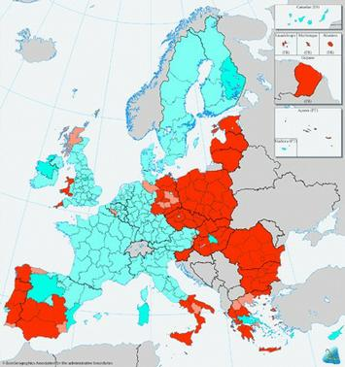
SF ALLOCATION 2007-20013- SF used for DI

Slide 3
NECESSERY COMPONENTS
L
LEGISLATION
Reform
SERVICES
FINANCING
QULITI
USERS
LEADERSHIP
AND
COORDINATION
OF
CHANGE

Slide 4
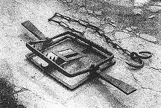
Traps- What is not “DI”
“HUMANIZATION”
RE –NAMING
MOVING ONLY A “BETTER” CLIENTS
DEVELOPING MINI INSTITUTIONS
CLOSING INSTITUTIONS WITHOU PROPER COMMUNITY SETTINGS
COMMUNITI SERVICES WITH INSTITUTIONAL CULTURE

Slide 5
WHAT IS “DEINSTITUTIONALIZATION”
Support in the Community
Institutional care

Slide 6
CHANGING A CULTURE
Institution oriented
To person oriented
Isolation from broader community
Clients are compelled living together
Not sufficient control over the live
Rigidity of routine
Block treatment
Paternalistic relationship
Rules of the institution are more important the needs of the clients
Inclusion in the community
Clients has to decide where and whit whom to live
Maximum support of the clients of his control over the life
Normalization principle
Support according a needs
Partnership between staff and clients
Team cooperation
Flexibility in care provision

Slide 7
Human rights framewo
UN Convention on the Rights of Persons Disabilities (CRPD).
Art.19: Living independently and being included in the community
live in the community- with needed assistance
full inclusion and participation – accessibility of the services for general public
choices equal to others:
with whom to live
where to live

Slide 8
SERVICES COMPONENTS
Individual approach with an ownership of the user
Housing
Income
General health care
Work-employment
Social life- leisure
Assisting in daily living
Mental health care include crisis intervention
Family support
Education

Slide 9
DEVELOP COMMUNITY SERVICES AND STOP ADMISSIONS TO INSTITUTIONAL CARE
DEVELOPING COMMUNITY SERVICES
COMMUNITY
SUPPORT FOR PEOPLE ON “WAITING” LIST
MUNICIPALITY

Slide 10
REGIONALIZATION OF INSTITUTIONS

Slide 11
PRINCIPLES OF CARE
MAXIMUM USE OF “NORMAL” COMMUNITI RESOURCES.
CHOICE
MENTAL HEALTH IN PRIMARY HEALTH CARE
REGIONALIZATION
CONTINUITI OF CARE
ASSERTIVNESS
GATE KEEPING

Slide 12
COMMON QUALITY FRAMEWORK
PRECONDITIONS FOR SERVICES DELIVERY
NEEDS OF PERSON SERVED
REQUIREMENTS FOR THE STAFF
BENEFITS AND SERVICE RESULTS
REQUIREMENTS FOR THE SERVICE
REQUIREMENTS FOR THE SERVICE PROVIDER
PRECONDITIONS FOR SERVICES DELIVERY

Slide 13
PRINCIPLES (CQS)
GOOD GOVERNANCE
PARTNERSHIP
RIGHTS
PARTICIPATION
COMPETENCE OF STAFF
ETHIC
PERSON CENTERED
COMPREHESIVNES
RESUT ORIENTATION

Slide 14
Developing and monitoring of quality of care
Quality
Quality standards
Inspection of quality
Professional development
Development supervision
Self monitoring
Users involvement in monitoring

Slide 15
Reducing Clients-Costs-Staff

Slide 16
INCREASING OF COSTS DURING FIRST YERS OF DI TRANSFORMAION

Slide 17
FI
FINANCING
System of moving money from institution to the community care
Financial motivation for institutional service provider to develop community services
Money follows the client (personal budget)
Allocation according level of needed support
Purchasing services on local level
Bridging fond

Slide 18
Users involvement and empowering
User
Gaining legal capacity
Full involvement to individual plane
Involvement to decision about service provision
Participation on National DI Policy
System of individual budget

Slide 19
Coordination of DI process
MJ,MF,ME,MIA
MH
MLSW
DI WG of
NATIONAL CENTRE FOR
DI
DEVELOPING STRATEGY AND ACTION PLANE
COORDINATION OF IMPLEMENTATION
PILOT PROJECTS
ASSISTING IN IMPLEMENTATION OF COMPLEX DI PROCESS

Slide 20
OBSTACLES
MISUNDERSTANDING WHAT IS DI
MISSING LEADERSHIP
IN STABILITI OF STATE OFFICIALS
DOMINATION OF INTERESTS WHICH ARE DIFFERENT THEN INTERST OF CLINTS
HIGH CORRUPTION
RIGIDITI OF FINANCING
CONCEPT OF FULL LEGAL INCAPACITI
POOR CLINTS REPREZENTATION

Slide 21
FREQUENT STATEMENTS-QUESTIONS
SITUATION IN OLD EU MEMBERSTATES IS DIFFERENT AND IDEA OF DI IS NOT FULLY APLICABLE TO NEW MEMBERSTATES
IT IS NOT REALISTIC EVERYBODY CAN BE ICLUDED IN THE COMMUNITI-INSTITUTIONS WILL BE NEEDED.
IT IS TO DANGEROUS (FOR OTHERS) ALL PEOPLE WITH MENTAL HEALT PROBLEMS ARE IN THE COMMUNITI.
WHERERE TO CLOSE INSTITUTIONS THERE WILL BE HIGH SUICIDE RISK AND HOMELESSNESS.
COMMUNITI CARE WILL BE MORE COSTLY.
PEOPLE WITH INTELECTUAL DISABILITI AN PSYCHO SOCIAL PROBLEMS CAN NOT DECIDE ON THEIR OWN- THEY NEED TO BE PROTECTECT.
PROFESSIONAL “KNOW BETTER” AN HAVE TO LEADE SERVICES

Slide 22
Way forward
System of monitoring and quality control
Analysis of legislative barriers-changing legislation
Development of needed trainings
Searching for additional resources
Stop admission to the institutions
Prevention of institutionalization
Development of community services
Effective use of all resources
Closure of institutions
Holistic coordination
Continual awareness

Slide 23
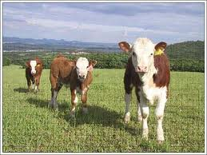
THANKS FOR ATTENTION
IMPORTANT TO KNOW WHERE TO GO
AD NO TO STOP WHEN THERE ARE OBSTACLES

